Slide 1

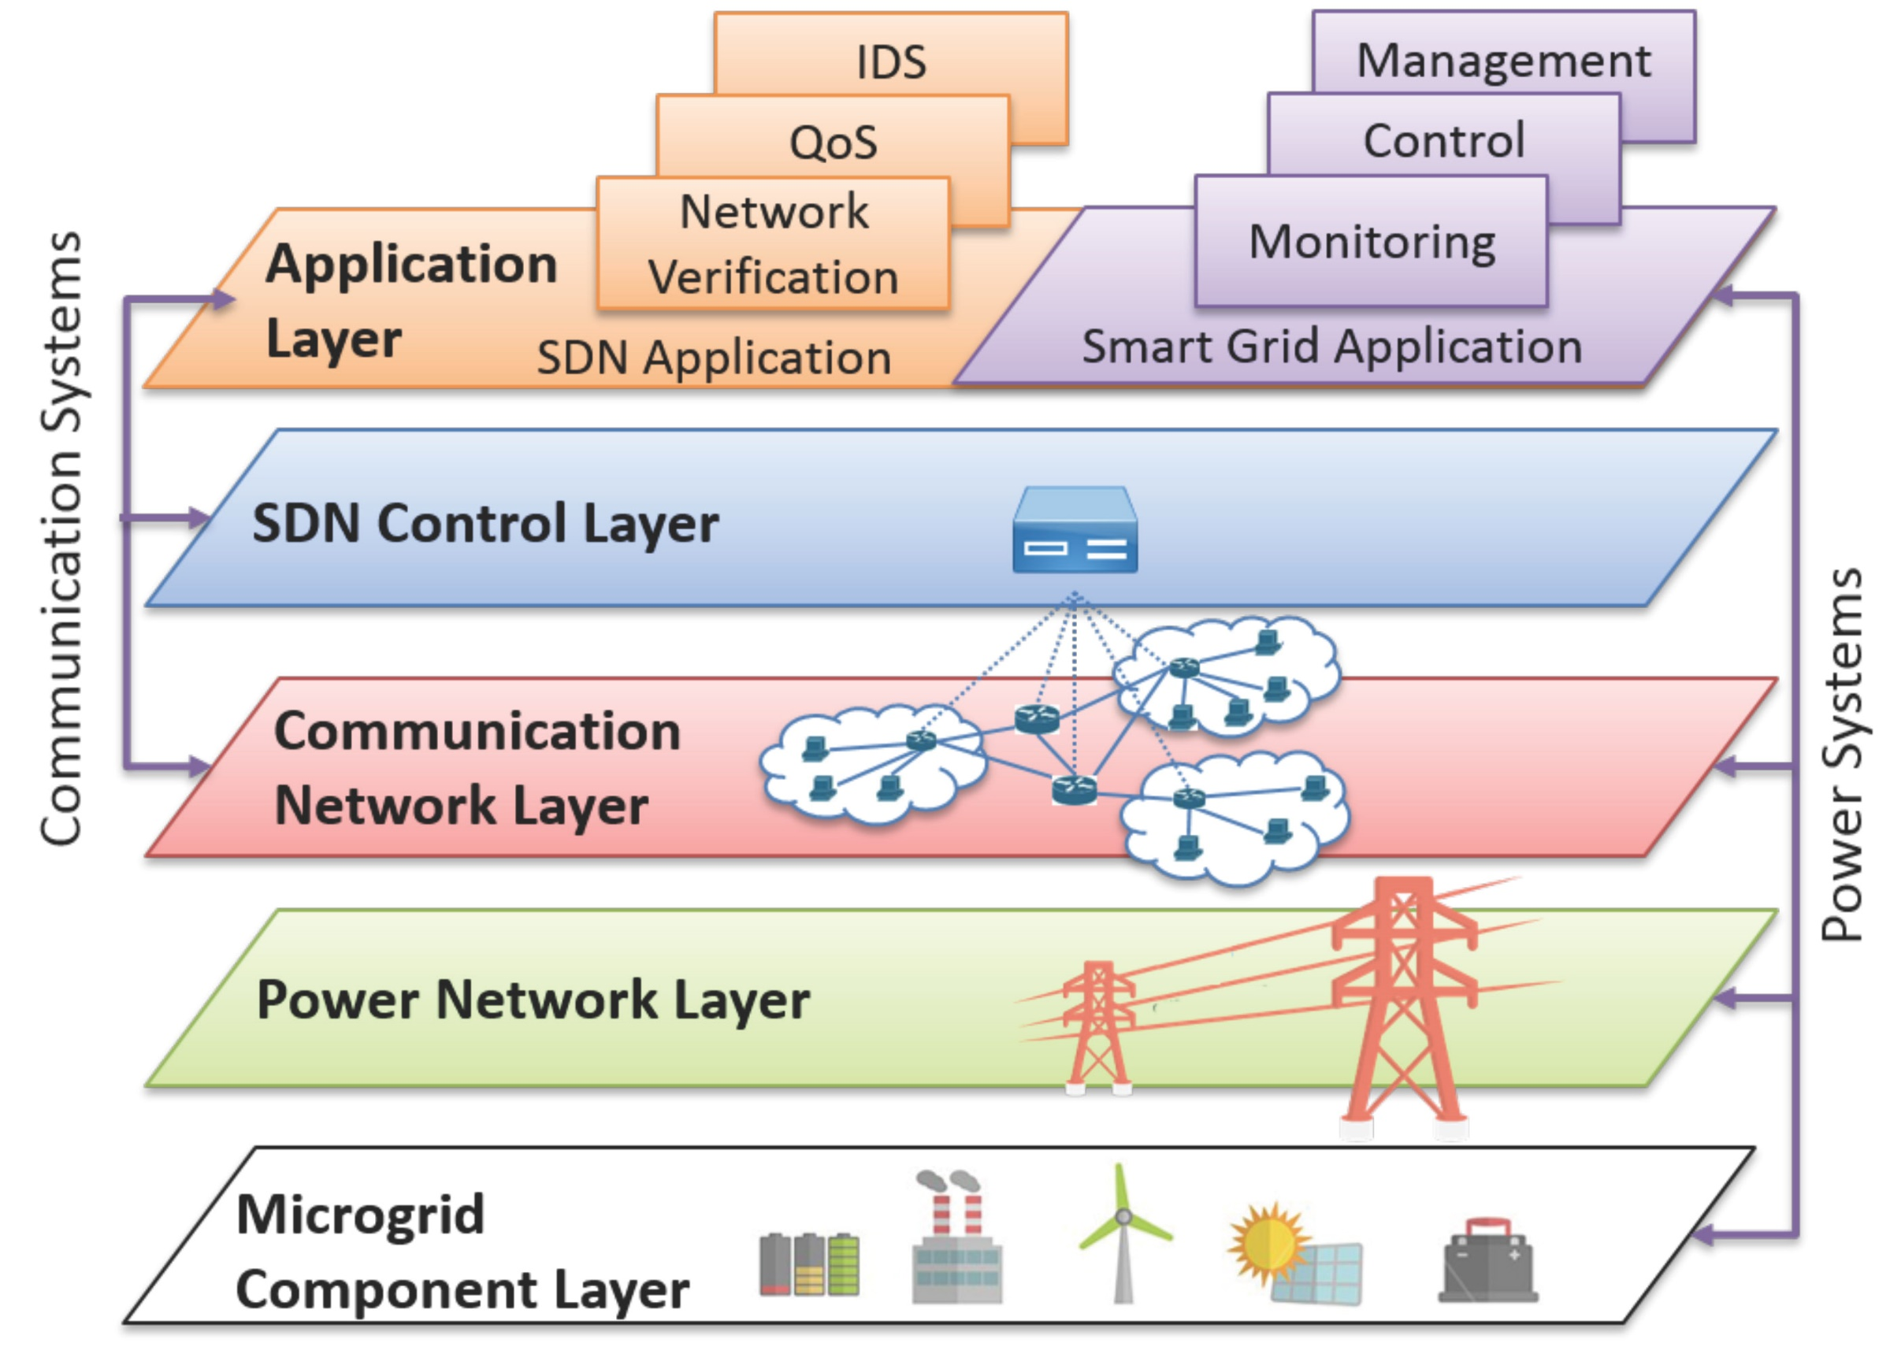
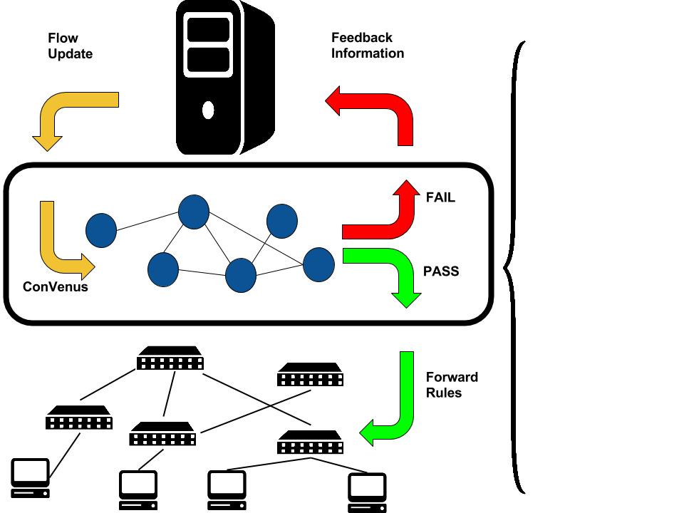
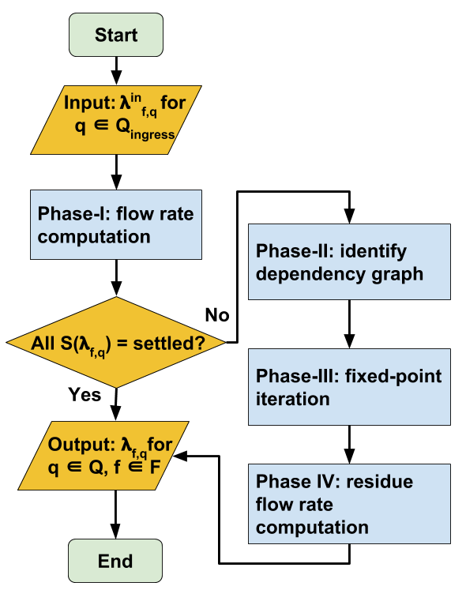
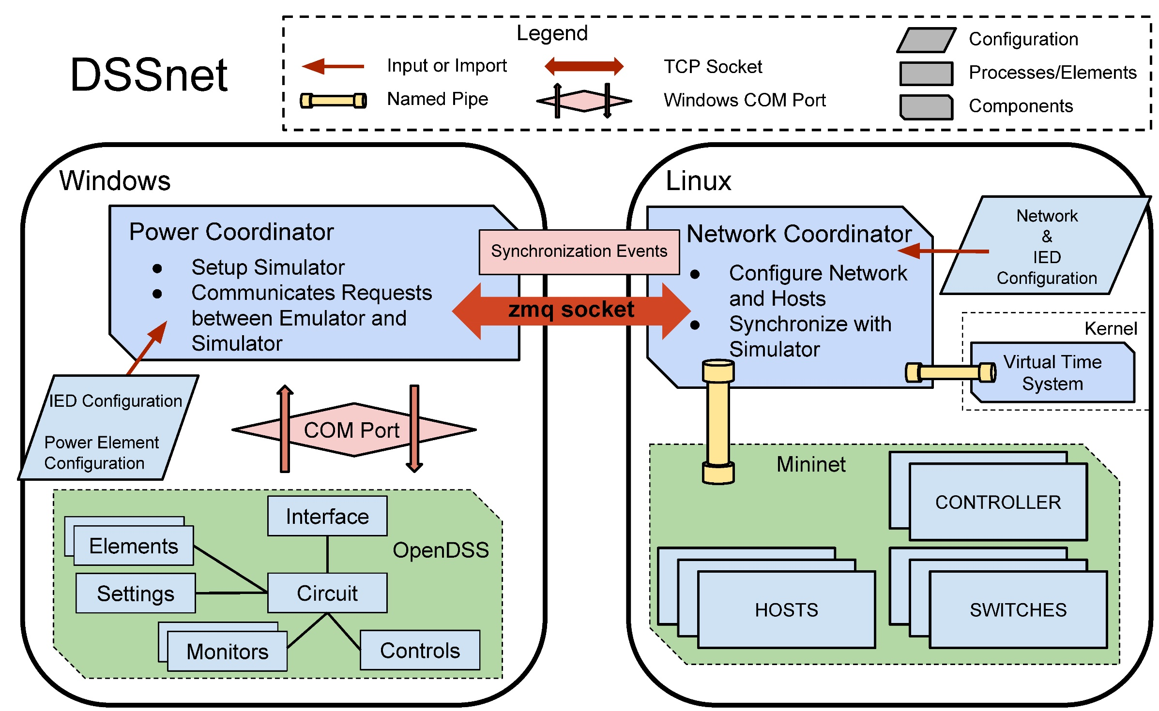
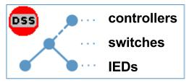
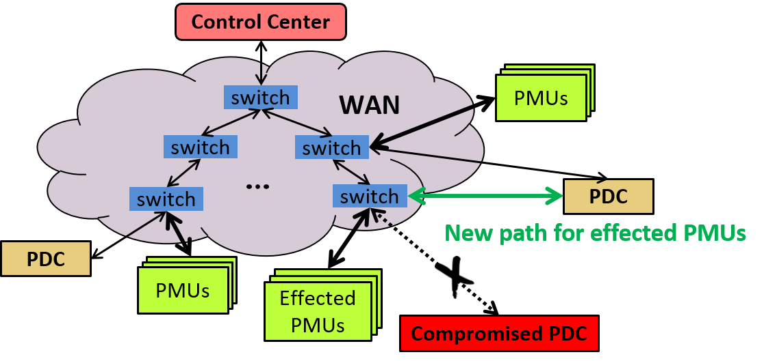

Towards a Secure and Resilient Industrial Control System with Software-Defined Networking
Dong (Kevin) Jin, Jiaqi Yan, Xin Liu, Christopher Hannon (Illinois Institute of Technology)
Cheol Won Lee (National Security Research Institute, South Korea)
Within the SDN-enabled smart grid
We install ConVenus between the control plane and the data plane to enforce the correct network-layer invariants (e.g., congestion-freedom).
On the data plane layer, we enhance the resilience of PMU networks against cyber attacks with SelfHealer.
We build a simulation/emulation testbed DSSnet to support high-fidelity analysis of cyber-attacks on SDN-enabled ICSes.
Modern Industrial Control Systems (ICS) increasingly rely on the computer and communication networks to efficiently monitor and control the critical physical processes. Compromising those networks can impact the successful operations of the critical infrastructures, including power grids, oil and gas distribution systems, weapon systems, etc. In this work, we apply the emerging SDN technology to secure ICSes in the context of Smart Grid, and investigate several innovative SDN-aware security applications.
SDN-based Approach
Motivation
Verify every incoming flow update rules from the control plane to the forwarding plane in real time
Preserve the congestion-freedom in time-critical and mission-critical ICS networks
ConVenus
Integrate electric power distribution system simulation (OpenDSS) with SDN network emulation (Mininet)
Test and evaluate SDN-aware applications for ICS resilience and security
Based on virtual-time-system-based synchronization
DSSnet
Directly program SDN switches upon attack detection so that
PMUs are isolated from the compromised PDCs;
Disconnected yet uncompromised PMUs are automatically reconnect to the network;
Power system observability is restored with minimal overhead during the self-healing process
SelfHealer

